Slide 1
Skeletal Disorders
Adrianna Senn Yuen

Slide 2
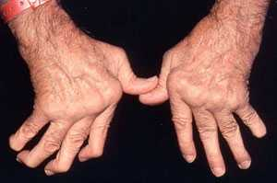
Beaux-Rheumatoid Arthritis
Rheumatoid Arthritis- Autoimmune and chronic disease occurs because of the immune system
Affects 1.3 million Americans (middle-aged)
http://www.cedars-sinai.edu/Patients/Health-Conditions/Images/354031_Adv_Rheumatoid_Arthritis-2sm.jpg

Slide 3
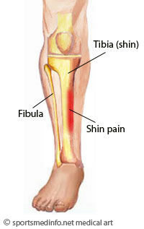
Alex A. -Medical Tibial Stress Syndrome
Medical Tribal Stress Syndrome disease is located in the medial of the bone or leg
Females are more prone to this disease because of their higher incidence
http://im.glogster.com/media/4/23/75/88/23758898.jpg

Slide 4
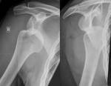
Brooke- Dislocation
Dislocations are injuries to a joint
Car accident, falling, sports
http://upload.wikimedia.org/wikipedia/commons/1/17/Dislocated_shoulder_X-ray_03.png

Slide 5
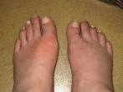
Alex H. – Gout
Gout- Joints get attack repetitively by inflammatory arthritis
Men 30-40, Women 60’s
http://ed-thelen.org/TheFaceOfGout-.jpg

Slide 6
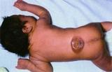
Heidy- Spina Bifida
Spina Bifida- birth defect in lower back or spine
Spanish and Caucasian are affected the most
http://trialx.com/curebyte/2011/05/29/clinical-trials-and-related-photos-for-spina-bifida/

Slide 7
Brittani- Osteopenia
Osteopenia is low bone density
Caucasian and Asian women 65 or older are more affected
http://trialx.com/curebyte/2011/06/01/what-is-osteopenia/

Slide 8
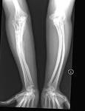
Shaina- Osteogenesis Imperfecta
Osteogenesis imperfecta- defect in the 17th chromosome
Baby is born with it, and affects women and men
http://www.beltina.org/pics/osteogenesis_imperfecta.jpg

Slide 9
Lix- Osteomyelitis
Osteomyelitis is a bacterial infection of bone and bone marrow
In children (long bones), vertebrate and pelvis in adults
http://upload.wikimedia.org/wikipedia/commons/thumb/5/59/Ostermyelitis_Tibia.jpg/230px-Ostermyelitis_Tibia.jpg

Slide 10
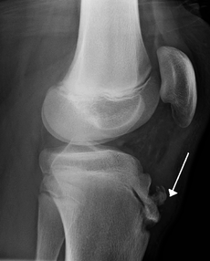
Ian- Osgood- Schaltter
Osgood- Schaltter is a painful lump in the kneecap
Ages 13-14 boys, 11-12 younger girls because of puberty
http://upload.wikimedia.org/wikipedia/commons/thumb/3/32/OsGood.PNG/230px-OsGood.PNG

Slide 11
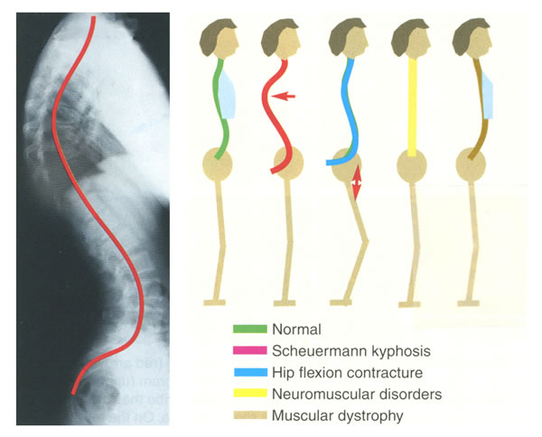
Tharidu- Lordosis
Lordosis is when a spine curves insignificantly
Younger people than older
http://www.seattlechildrens.org/uploadedImages/Seattle_Childrens/cmsassets/Images/kyphosis_large.jpg

Slide 12
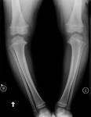
Trey- Blount
Blount growth disorder in the shin
African American children and obese people
http://images.radiopaedia.org/images/406398/90d5cde16e8014fd0a87e3b6c66168.jpg

Slide 13
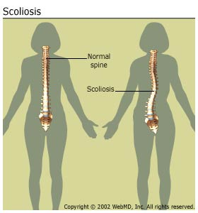
Emily- Scoliosis
Scoliosis is the abnormal curving of the spine
Childern 3 and younger, mostly females
http://img.webmd.com/dtmcms/live/webmd/consumer_assets/site_images/articles/health_and_medical_reference/joints_bones_and_muscles/arthritis-scoliosis_scoliosisspine.jpg

Slide 14
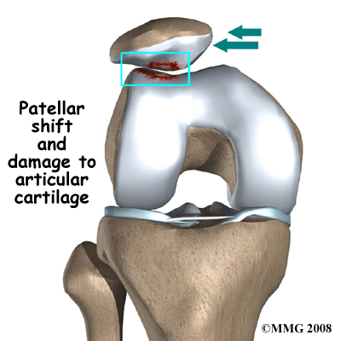
Samantha- Chondromalcia
Chondromalcia- is the degeneration cartilage in the knee
Young adults
http://www.eorthopod.com/images/ContentImages/knee/knee_patella_chondromalacia/knee_chondromalacia_cause01.jpg

Slide 15
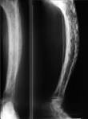
Shayvani- Pagets
Pagets disease- disorder that involves abnormal bone destruction and regrowth
Older people
http://image.funscrape.com/images/p/pagets_disease-2063.jpg

Slide 16
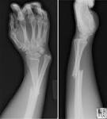
Andi- Fractures
A fracture is a complete or incomplete break in a bone due to high amount of force
Athletes, Elderly
http://www.learningradiology.com/caseofweek/caseoftheweekpix2/cow157lg.jpg

Slide 17
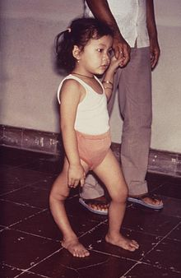
Sam- Poliomyelitis
Poliomyelitis is the inflammation of the neurons in the spine and brain
Anyone of any age
http://upload.wikimedia.org/wikipedia/commons/thumb/8/8a/Polio_sequelle.jpg/220px-Polio_sequelle.jpg

Slide 18
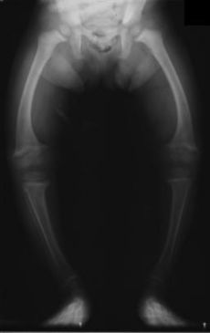
Alex B.- Rickets
Rickets- childhood disease softening of bones
Younger children
http://upload.wikimedia.org/wikipedia/commons/thumb/a/a9/XrayRicketsLegssmall.jpg/230px-XrayRicketsLegssmall.jpg

Slide 19
Shane- Osteothritis
Osteothritis- Joint inflammation
50 years above or 25 years
http://health.nytimes.com/health/guides/disease/osteoarthritis/print.html

